Slide 1
2022 Arizona Youth Survey
2022
Arizona Criminal Justice Commission

Slide 2
What is this Arizona Youth Survey (AYS) I Keep Hearing All About?
Mandated by A.R.S. §41-2416
Biennial survey of 8th, 10th, and 12th grade students in schools across all 15 counties
Assesses the frequency of problematic behaviors and their correlates
Based on nationally recognized surveys, including Communities that Care (CTC) and Monitoring the Future (MTF)
The AYS is administered by teachers or other administrators in each school.
The survey is:
Anonymous Voluntary Free for schools
Available online or paper-pencil format
Administered on a day specified by the school
Passive parental consent forms
The AYS is the nation’s largest, longest running survey of youth

Slide 3
Table 1. Participation in the 2022 Arizona Youth Survey
 | AYS Participants |  | State Total |  | Participation Rate
 | Schools | Students | Schools | Students | Schools | Students
County
Apache | 4 | 422 | 28 | 2,403 | 14% | 18%
Cochise | 16 | 2330 | 45 | 4,413 | 36% | 53%
Coconino | 9 | 1724 | 37 | 4,150 | 24% | 42%
Gila | 4 | 594 | 20 | 1,658 | 20% | 36%
Graham | 5 | 396 | 19 | 1,463 | 26% | 27%
Greenlee | 2 | 212 | 4 | 379 | 50% | 56%
La Paz | 4 | 283 | 10 | 511 | 40% | 55%
Maricopa | 174 | 32,201 | 737 | 180,484 | 24% | 18%
Mohave | 15 | 2,137 | 33 | 5,126 | 45% | 42%
Navajo | 5 | 767 | 39 | 4,199 | 13% | 18%
Pima | 18 | 3,474 | 188 | 34,034 | 10% | 10%
Pinal | 15 | 2,132 | 74 | 13,029 | 20% | 16%
Santa Cruz | 8 | 1,724 | 16 | 2,543 | 50% | 68%
Yavapai | 15 | 2,208 | 64 | 5,689 | 23% | 39%
Yuma | 7 | 844 | 34 | 9,094 | 21% | 9%
Total
State | 301 | 51,448 | 1,350 | 269,175 | 22% | 19%
2022 AYS
Participation
Table 2. Summary of Participants
 | State 2018 |  | State 2020 |  | State 2022 |  | NCES State Total 2020-2021*
 | Number | Percent | Number | Percent | Number | Percent | Number | Percent
Students by Grade
Grade 8 | 17,144 | 35.0 | 9,843 | 32.8 | 22,380 | 43.5 | 90,501 | 33.6
Grade 10 | 17,748 | 36.2 | 11,267 | 37.5 | 17,464 | 33.9 | 88,566 | 32.9
Grade 12 | 14,099 | 28.8 | 8,942 | 29.8 | 11,604 | 22.6 | 90,108 | 33.5
Students by Gender
Male | 24,297 | 50.0 | 14,913 | 50.0 | 25,459 | 49.6 | 136,050 | 50.5
Female | 24,334 | 50.0 | 14,920 | 50.0 | 25,859 | 50.4 | 133,125 | 49.5
Students by Race/Ethnicity
White (non-Hispanic) | 18,347 | 37.7 | 13,534 | 45.3 | 16,857 | 32.9 | 100,106 | 37.2
Hispanic | 22,668 | 46.6 | 11,972 | 40.1 | 26,377 | 51.6 | 124,527 | 46.3
African American (non-Hispanic) | 2,320 | 4.8 | 1,301 | 4.4 | 2,526 | 4.9 | 14,868 | 5.5
American Indian (non-Hispanic) | 1,640 | 3.4 | 862 | 2.9 | 2,017 | 3.9 | 12,411 | 4.6
Asian/Pacific Islander (non-Hispanic) | 1,490 | 3.1 | 835 | 2.8 | 1,308 | 2.6 | 8,840 | 3.3
Multi-racial | 2,228 | 4.6 | 1,369 | 4.6 | 2,075 | 4.1 | 8,423 | 3.1

Slide 4
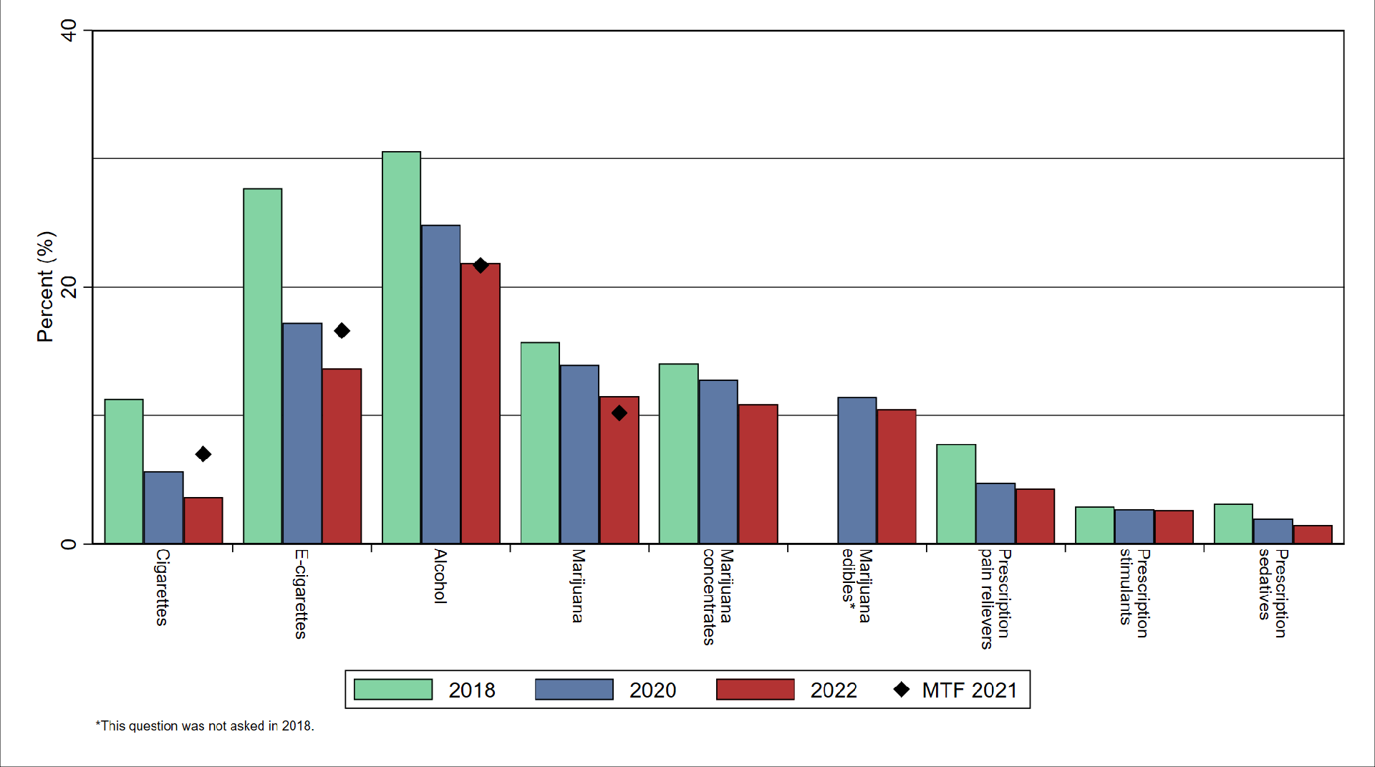
Grade 8 Substance Use
Lifetime

Slide 5
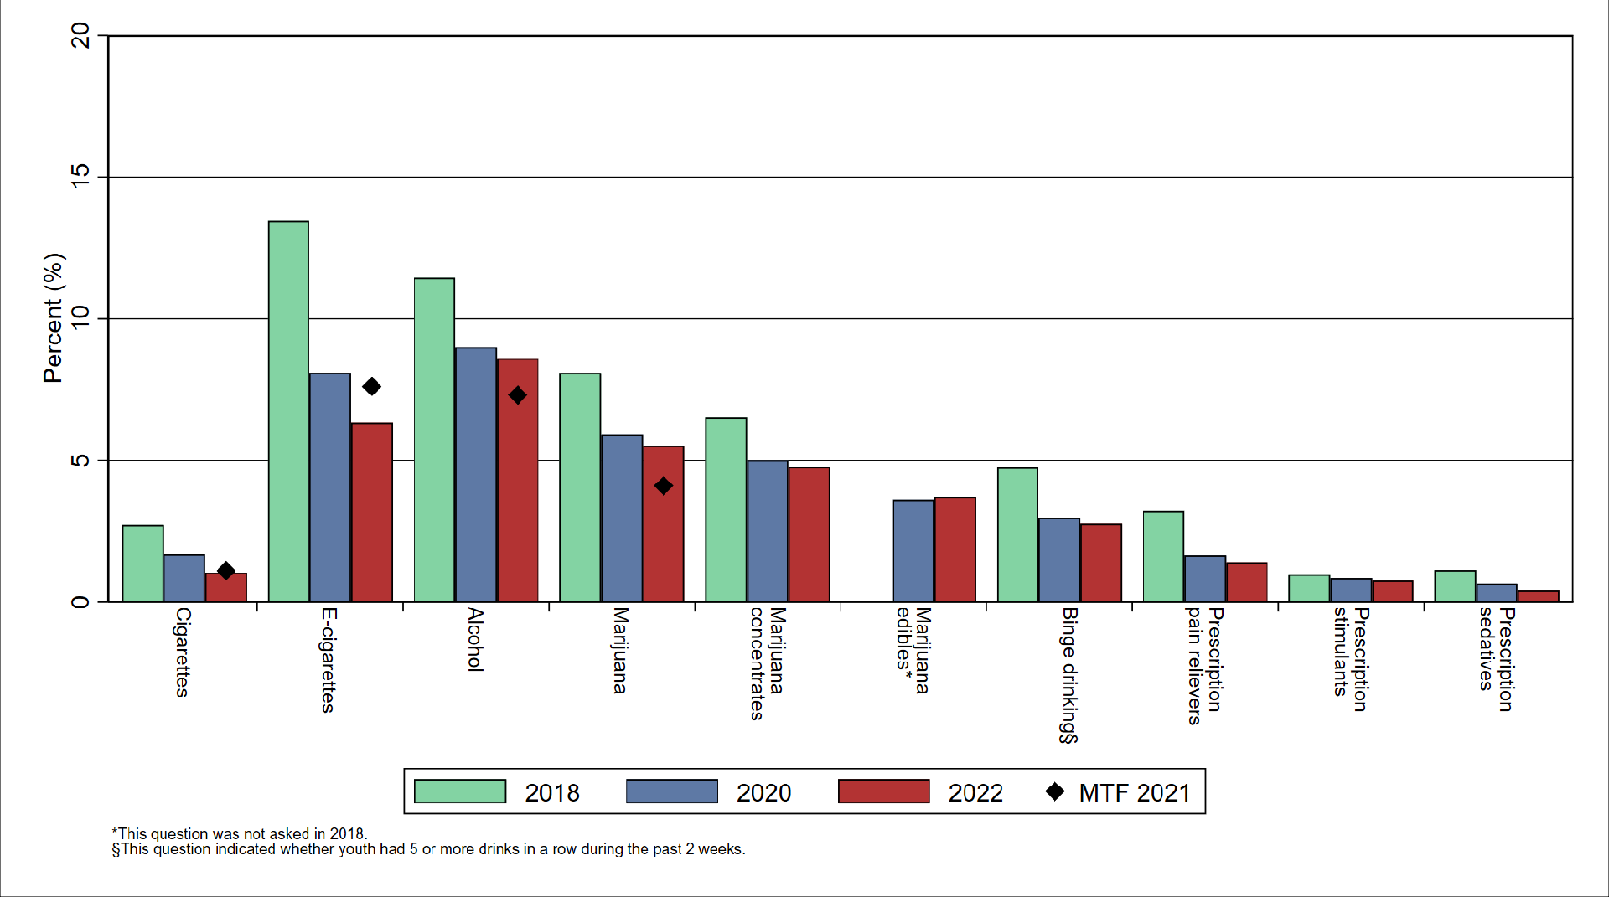
Grade 8 Substance Use
Past 30 Days

Slide 6
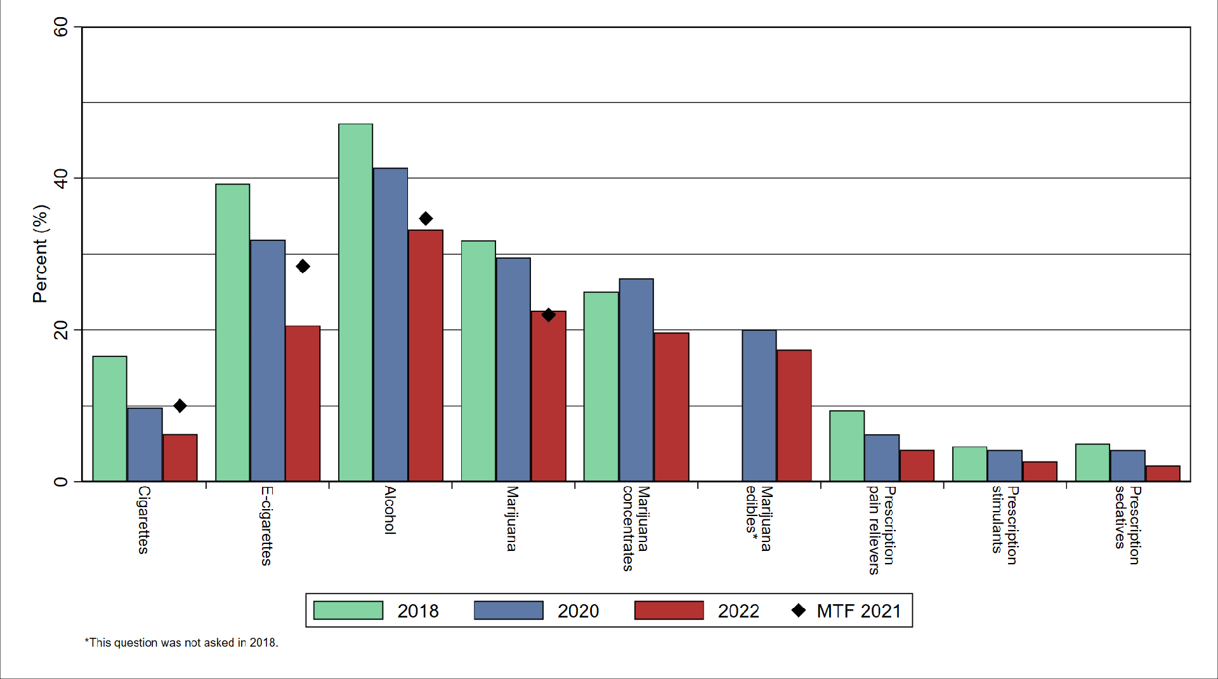
Grade 10 Substance Use
Lifetime

Slide 7
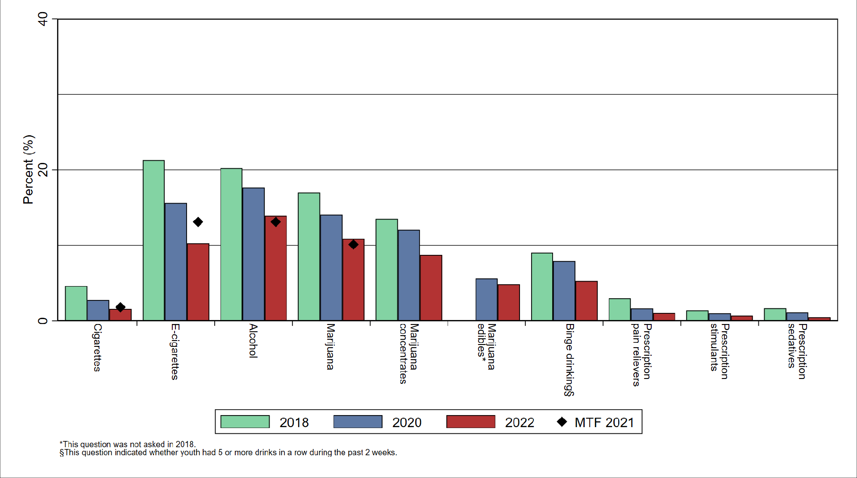
Grade 10 Substance Use
Past 30 Days

Slide 8
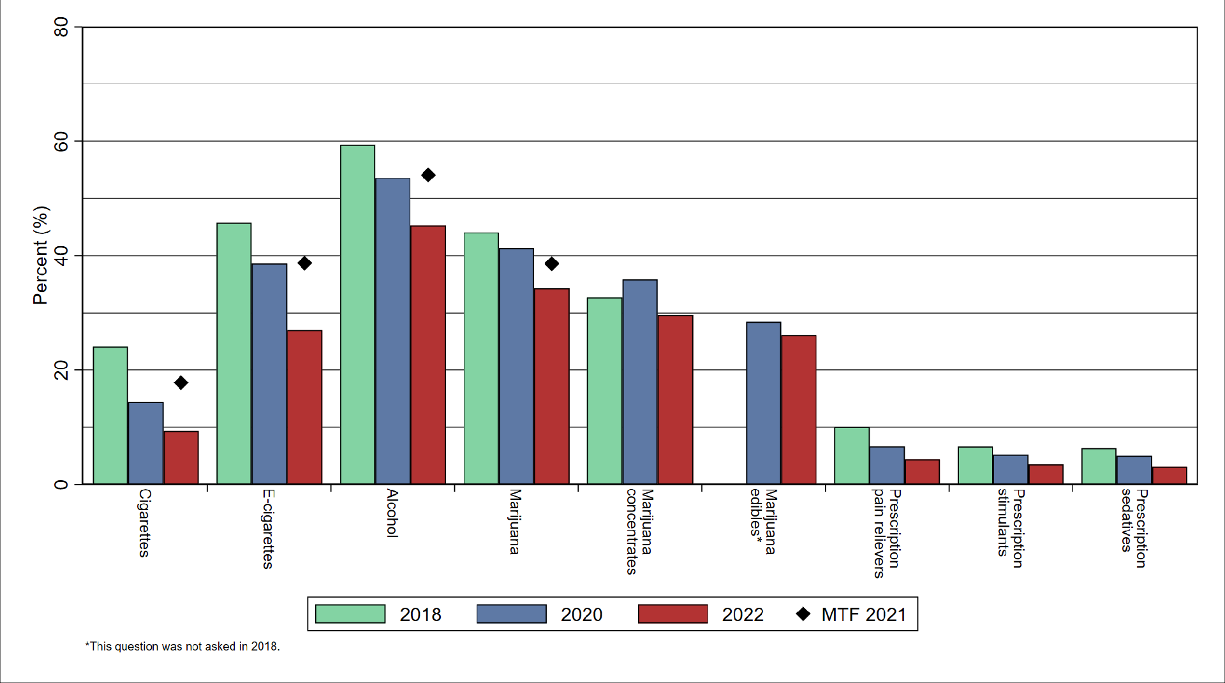
Grade 12 Substance Use
Lifetime

Slide 9
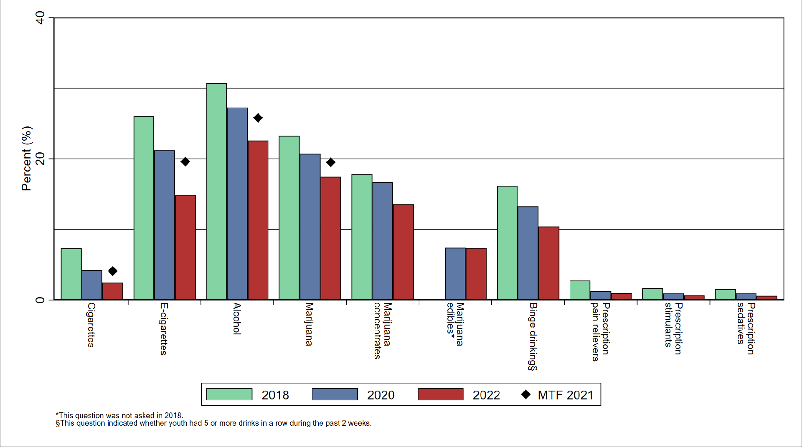
Grade 12 Substance Use
Past 30 Days

Slide 10
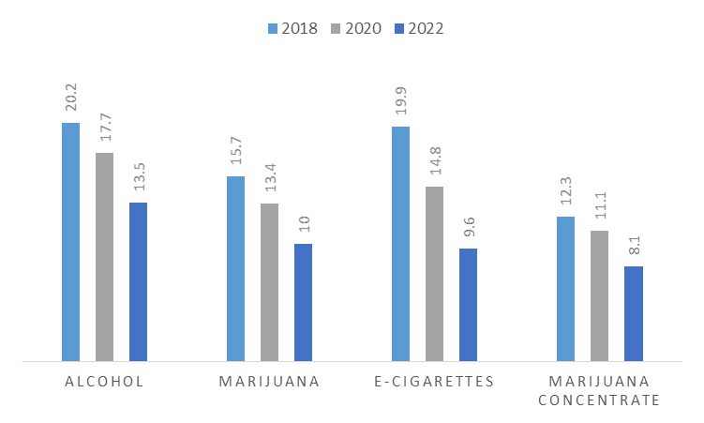
Youth Substance Use – Key Points
Overall trends in substance use continue to go down!
Most commonly Abused Substances (Grade 12, past 30 days)
Alcohol – 22.6%
Marijuana – 17.5%
E-cigarettes – 14.8%
Marijuana Concentrates – 13.6%
*If you look at lifetime use, marijuana concentrates jumps to #3
Female students continue to report a higher rate of abuse across all types of substances (past 30 days)
Female Male
Alcohol 16.1% 10.9%
Marijuana 11.2% 8.8%
E-cigarettes 11.6% 7.5%
Marijuana Concentrates 9.2% 6.9%

Slide 11
Youth Substance Use – Key Points
Where Youth are Getting substances – this continues to be dominated by friends and family as the primary sources for obtaining alcohol, marijuana, and prescription drugs
Most Common Reasons for Using Alcohol and Drugs:
To have fun – 42.5%
To get high or feel good – 35.9%
To deal with stress from my school – 35%
To deal with stress from my parents and family – 30.2%
I was feeling sad or down – 30.1%
To deal with stress from my peers or friends – 22.6%
Most Common Reasons for Not Using Alcohol and Drugs:
Not interested in drugs – 87%
Parents would be disappointed – 70.7%
It can harm my body – 69.8%
Illegal and I could get arrested – 55.9%
Parents would take away privileges – 54.5%
Other adults would be disappointed – 49.6%
These measures of risk and protective factors are where the AYS is really valuable to schools and substance abuse coalitions → it tells you where to focus your resources and efforts to produce change

Slide 12
New Questions on Fentanyl
Table 20. Fentanyl
Have you ever used the drug fentanyl? | Grade 8 |  |  | Grade 10 |  |  | Grade 12 |  |  | Total
 | 2018 | 2020 | 2022 | 2018 | 2020 | 2022 | 2018 | 2020 | 2022 | 2018 | 2020 | 2022
I have never heard of that drug. | n/a | n/a | 47.0 | n/a | n/a | 33.7 | n/a | n/a | 24.7 | n/a | n/a | 37.8
No | n/a | n/a | 51.2 | n/a | n/a | 64.2 | n/a | n/a | 72.8 | n/a | n/a | 60.2
Yes | n/a | n/a | 1.8 | n/a | n/a | 2.0 | n/a | n/a | 2.5 | n/a | n/a | 2.0
Fentanyl Awareness
During the past 12 months, have you talked with a parent or guardian about the dangers of fentanyl? | n/a | n/a | 14.3 | n/a | n/a | 19.1 | n/a | n/a | 19.7 | n/a | n/a | 17.1
During the past 12 months, do you recall seeing or hearing a local advertisement, billboard, or commercial about the dangers of fentanyl use? | n/a | n/a | 20.6 | n/a | n/a | 28.2 | n/a | n/a | 34.1 | n/a | n/a | 26.0
How much do you think people risk harming themselves (physically or in other ways) if they...
use fentanyl: great risk.* | n/a | n/a | 61.8 | n/a | n/a | 73.8 | n/a | n/a | 78.3 | n/a | n/a | 70.3
How easy would it be for you to get the following things if you wanted them:
fentanyl: sort of easy or very easy.* | n/a | n/a | 7.8 | n/a | n/a | 10.9 | n/a | n/a | 12.7 | n/a | n/a | 10.2
*Among students who had heard of fentanyl. All questions were added in 2022.

Slide 13
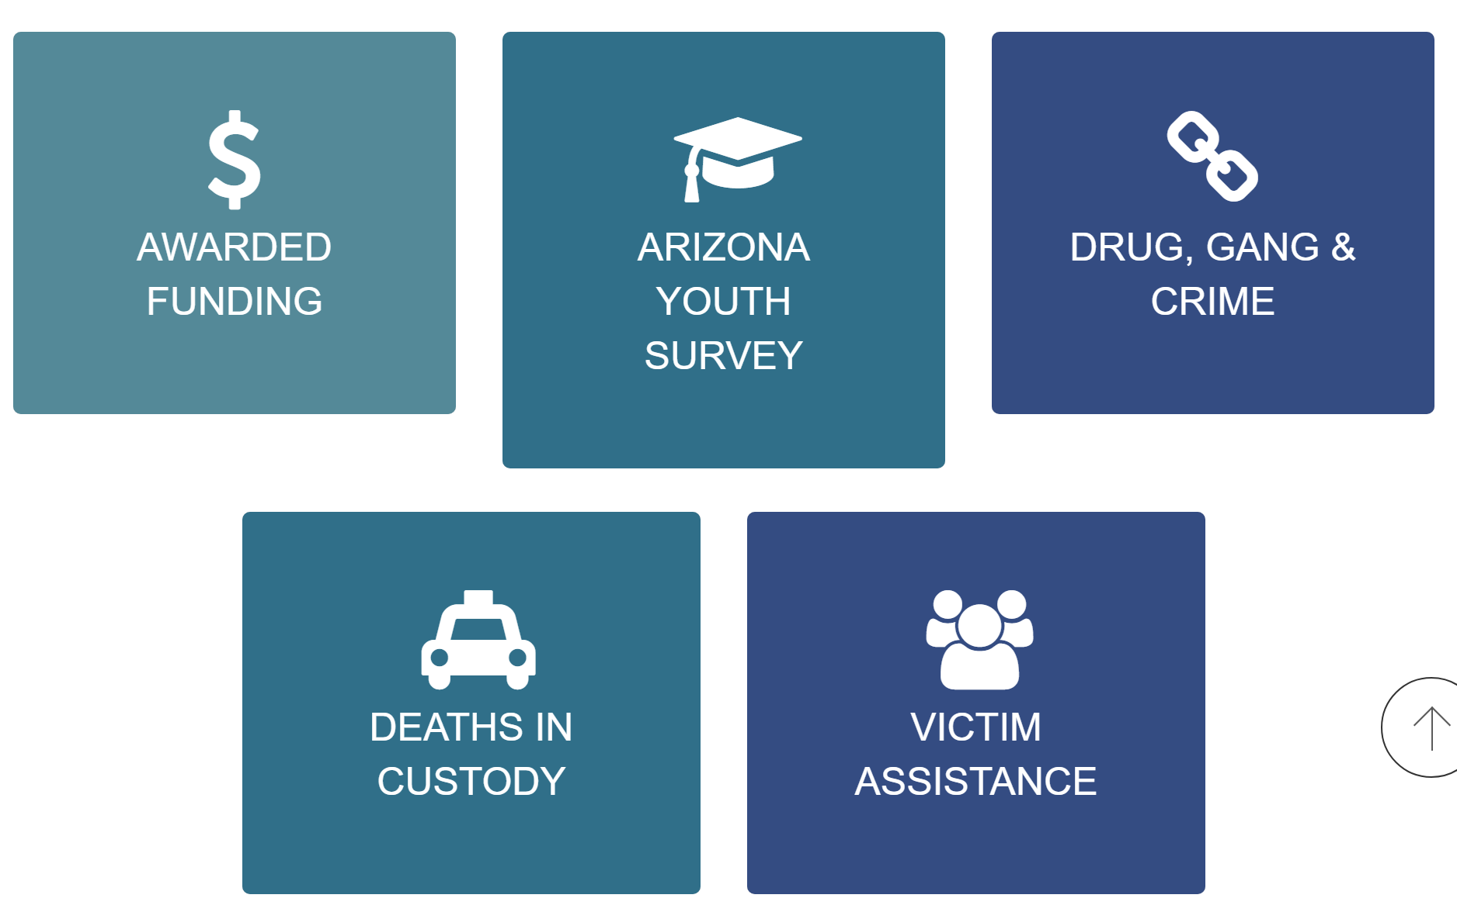
ACJC Data Visualization Center
From ACJC’s website you can access the DVC by clicking on the “Data” tab at the top or by typing – www.azcjc.gov/data into your browser.

Slide 14
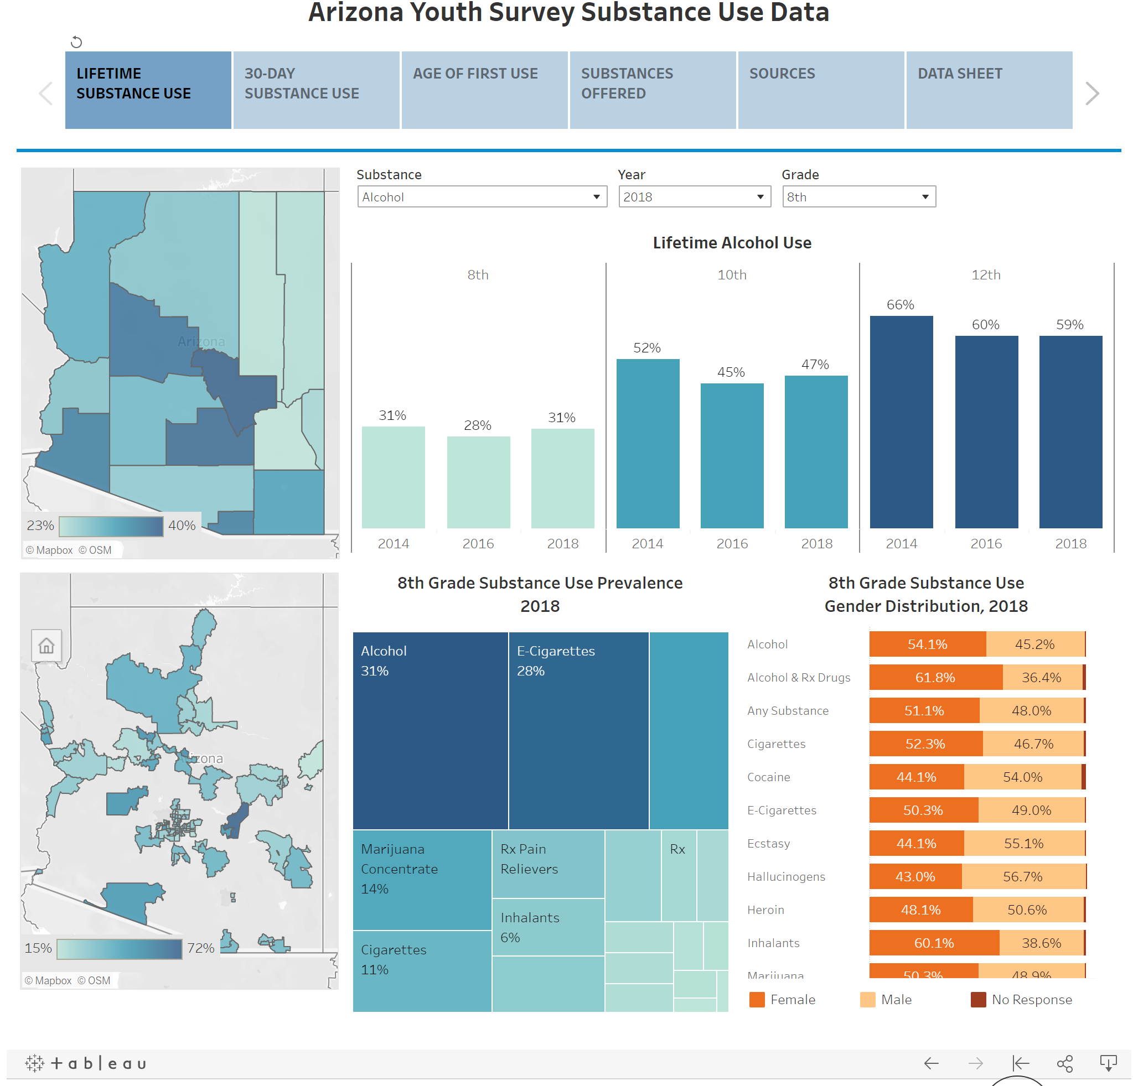

Slide 15
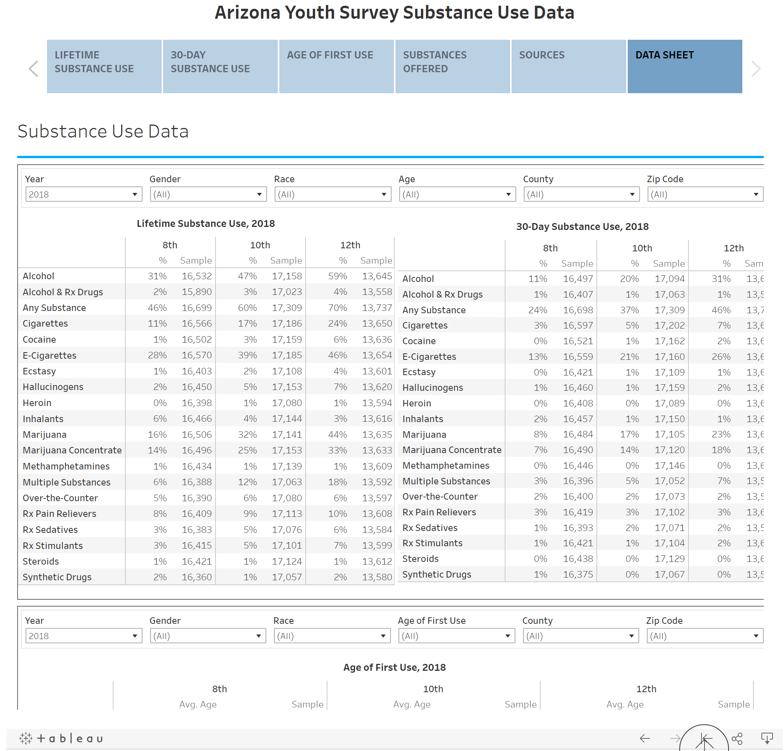

Slide 16
Final Thoughts
Here is my call to action…
Nearly half our 8th graders, a third of our 10th graders, and a quarter of our 12th graders have not heard of fentanyl → this can not stand
When are we going to have our “This is your brain on drugs” moment with fentanyl?
Go home tonight and talk to your sons and daughters, we know from the data that they will listen
And no:
They are not too young
You don’t live in too nice of a neighborhood
They don’t hang out with the right friends
They would never try drugs
If they don’t hear from you…then who are they listening too?

Slide 17
Matt Bileski, Program Manager
Data Integration, Analytics and Optimization
Arizona Criminal Justice Commission
mbileski@azcjc.gov
602-364-1374
Ana Z. Daniels, Senior Research Analyst & Interim Director
Statistical Analysis Center
Arizona Criminal Justice Commission
adaniels@azcjc.gov
602-364-1191
www.azcjc.gov

Slide 18
2022

